Slide 1
Wind Turbine Energy Prediction
Palivela Jaya Siva Santhosh

Slide 2
PROBLEM STATEMENT
Wind energy forecasting plays an important role in wind energy utilization,which is a vital component of wind energy management.In power systems, balance is maintained by continuously adjusting generation capacity and by controlling demand. As wind is a dynamically changing variable,the whole problem can be taken as a time series forecasting.Short-term forecasts (ranging from 1 h up to 72 h) are useful in power system planning for unit commitment and dispatch, and for electricity trading in certain electricity markets where wind power and storage can be traded or hedged..

Slide 3
SOLUTION
To overcome the disadvantages of conventional models, advanced deep learning models such as LSTM (Long Short Term Memory) , can be used to map the inherently variable attribute to a complex function. LSTM is well-suited to predict time series given time lags of unknown duration. Relative insensitivity to gap length gives an advantage to LSTM over alternative RNNs, hidden Markov models and other sequence learning methods. Since the wind speed and wind degree vary from place to place ,it is not possible to develop a generalized model which can predict the energy output of the wind farms located all around the world. As a part of our problem statement, Muppandal wind farm situated in TamilNadu at co-ordinates 8.2600 N 77.5475 E, is taken as a use case to train the LSTM model.The proposed LSTM model consists of four layers and computationally less expensive than other deep learning LSTM architectures.

Slide 4
Technology stack
Packages
Pandas
NumPy
Matplotlib
Seaborn
sklearn

Slide 5
Applications
1. The same model mentioned above can also be applied to other data such
as Solar energy, tidal energy etc.
2. The model can be transfer-learned for making predictions for other
locations, instead of training from scratch. This reduces the time
taken for training.
3. The application can also be used as a standalone REST API
calls

Slide 6
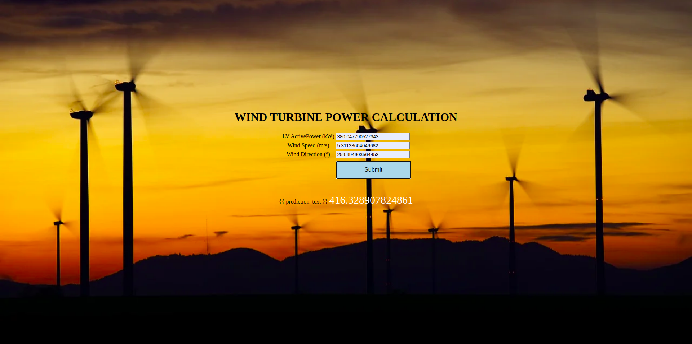
OUTPUT

Slide 7
Advantages and disadvantages
1. Intuitive User Interface
2. Faster Predictions on just a click of a button
3. Accurate predictions upto 1 hour to 72 hours
4. 48 predictions per hour for more accurate Power Output visualiztion
5. The Power grids can make use of this app to efficiently monitor the wind
turbine power output.
6. An additional feature : Weather Now, to display the current weather at the
location is added to the application.
7. The model is also trained to predict direction of the wind and can be used
for the alignment of the turbines.
DISADVANTAGES:
1. On device Deep Learning model cannot be used. The predictions must be made through
REST API call to the model.
2. The time taken for predictions is thus comparitively little less.
3. The model is trained only on Muppandal, Kanyakumari, Tamil Nadu,India
weather data i.e.Region specific. There is scope for generalizing the model to suit
for various other regions.

Slide 8
Conclusion
A Deep Learning model, based on Long Short Term Memory(LSTMs)
has been developed to forecast the Power output of the wind turbine.
A simple, efficient and a versatile model is built keeping in mind the
diversity of data, computational complexity and overhead involved in
making API calls to the model for prediction.
The product can increase the accuracy of the forecasting the output
from the wind turbine .Overall accurate wind power prediction reduces
the financial and technical risk of uncertainty of wind power
production for all electricity market participants

Slide 9
Future scope
1. A more generalized model can be developed to suit forecasting
for different locations.
2. The model can be developed to make predictions on other sources
of data such as solar power, tidal power etc.
3. On-device model can be developed to make much more faster
predictions.

